Slide 1
Cifar-10 Image Classification
Team:
Akshatha Vallampati
Swathi Shashidhar
Hasini Patlolla

Slide 2
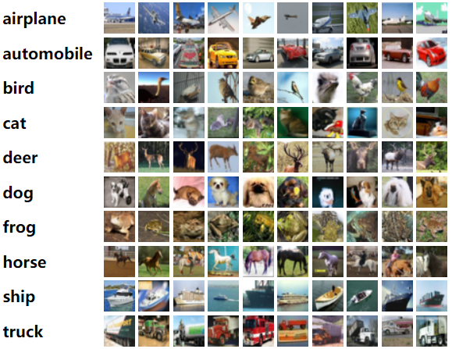
Dataset Description
The CIFAR-10 dataset is a collection of 60,000 images, each measuring 32x32 pixels and categorized into 10 classes.

Slide 3
Introduction
Objective
Goal
Methodology
Notes:
Objective: The objective is to develop a deep learning model using CNNs to accurately classify images in the CIFAR-10 dataset, optimizing for high performance.
Goal: Main goal is to achieve precise classification of CIFAR-10 dataset images using CNNs, optimizing for accuracy and performance in deep learning.
Methodology: Utilized deep learning, particularly CNNs, for effective image classification, leveraging their ability to extract hierarchical features.

Slide 4
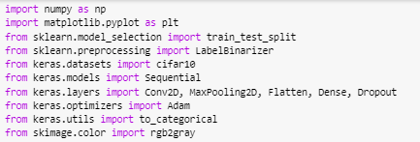

Data Preprocessing
Importing the Libraries
Downloading and loading the dataset
Normalizing pixel values

Slide 5

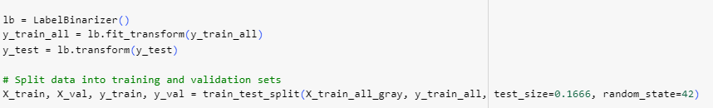
Contd…
Converting RGB images to grayscale
One-hot encoding labels
Train and test data split

Slide 6

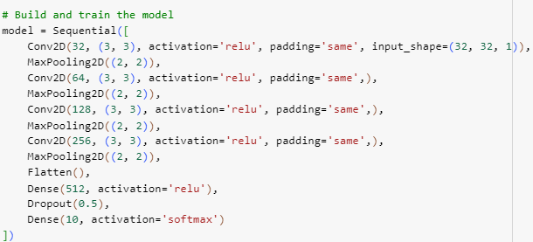
CNN Architecture Model
Convolutional layers for feature extraction
Max pooling layers for down-sampling
Dense layers for classification
Dropout layers for regularization

Slide 7
Hyperparameter Tuning and Model Training
Learning rate: 0.001 (set in the Adam optimizer)
Batch size: 128 (used in model.fit())
Number of epochs: 20 (used in model.fit())
Size of hidden layers:
Four convolutional layers: (32, 64, 128, 256) with kernel size (3, 3)
For dense layers: 512 nodes

Slide 8

Model Evaluation
Accuracy
Precision
Recall
F1 Score

Slide 9
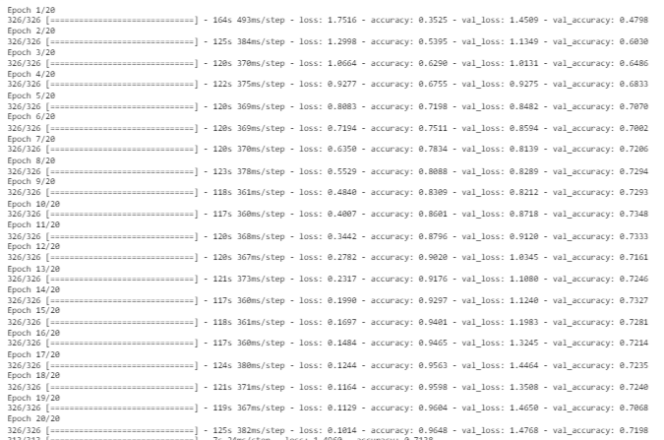
Training the data

Slide 10
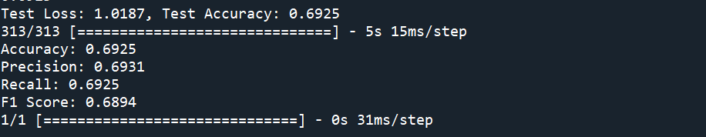
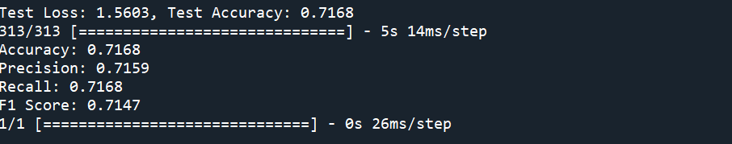
Results and Discussion
For 3 CNN layers with learning rate=0.001
For 4 CNN layers with learning rate=0.001

Slide 11
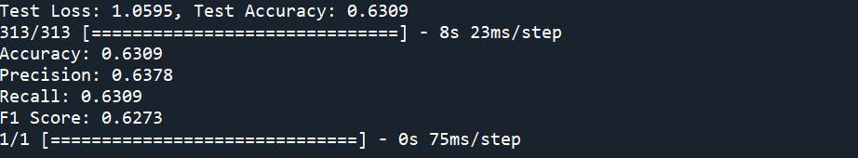
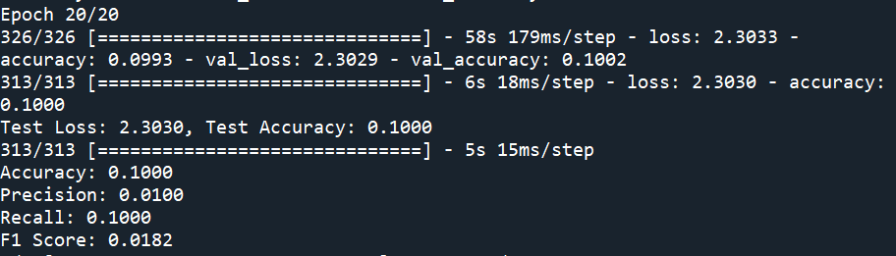
Contd…
For 4 CNN layers with learning rate=0.0001
For 4 CNN layers with learning rate=0.01

Slide 12
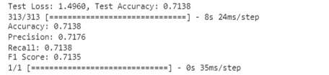
Contd…
For 4 CNN layers with learning rate=0.001

Slide 13
Applications
Automotive
Warehouse
Medical
Crime Investigation

Slide 14
Conclusion
Successfully developed a CNN model for CIFAR-10 image classification.
The project demonstrated the efficacy of deep learning in achieving high accuracy.
This underscores the significance of leveraging advanced techniques like CNNs in image classification tasks, paving the way for future advancements.

Slide 15


